Slide 1
Sonoma Underground EST. 2005
Sonoma Underground Services Inc. is a premier utility contractor certified with the City of Chicago, State of Illinois and Department of Transportation as a Minority Business Enterprise\ Disadvantage Business enterprise. Specializing in directional boring, large diameter boring, river crossings and trenching within the crowded streets of Chicago, Sonoma Underground has the skills to get your job done with the highest of quality.

Slide 2
specializing in directional boring, rock drilling, and multiple duct placement

Slide 3
Sonoma safety
With a work practice of “safety first” Sonoma Underground maintains a safety mod rating of .80 or better

Slide 4
Sonoma safety
Safety:
Sonoma Underground Services is dedicated to its employees and it’s customers to providing a safe working environment. With a work practice of “Safety First” Sonoma continues to work with its employees, their clients and all governing bodies to constantly expand their safety program.
Sonoma Underground Services’ Safety Program starts with it’s employees. Every employee has been extensively trained in:
Sonoma Underground’s Safety Program
First Aid
CPR
OSHA 10/OSHA 30
Confined Space
Competent Person
Sonoma’s Management Team have all been OSHA 30 Certified.
Completing weekly tailgate meetings and Safety Audits on all of our jobsites are just a couple of ways that Sonoma Underground assures its clients that the work performed will be completed in the safest manor possible, therefore providing a safe worksite for its employees, clients and the general public.

Slide 5
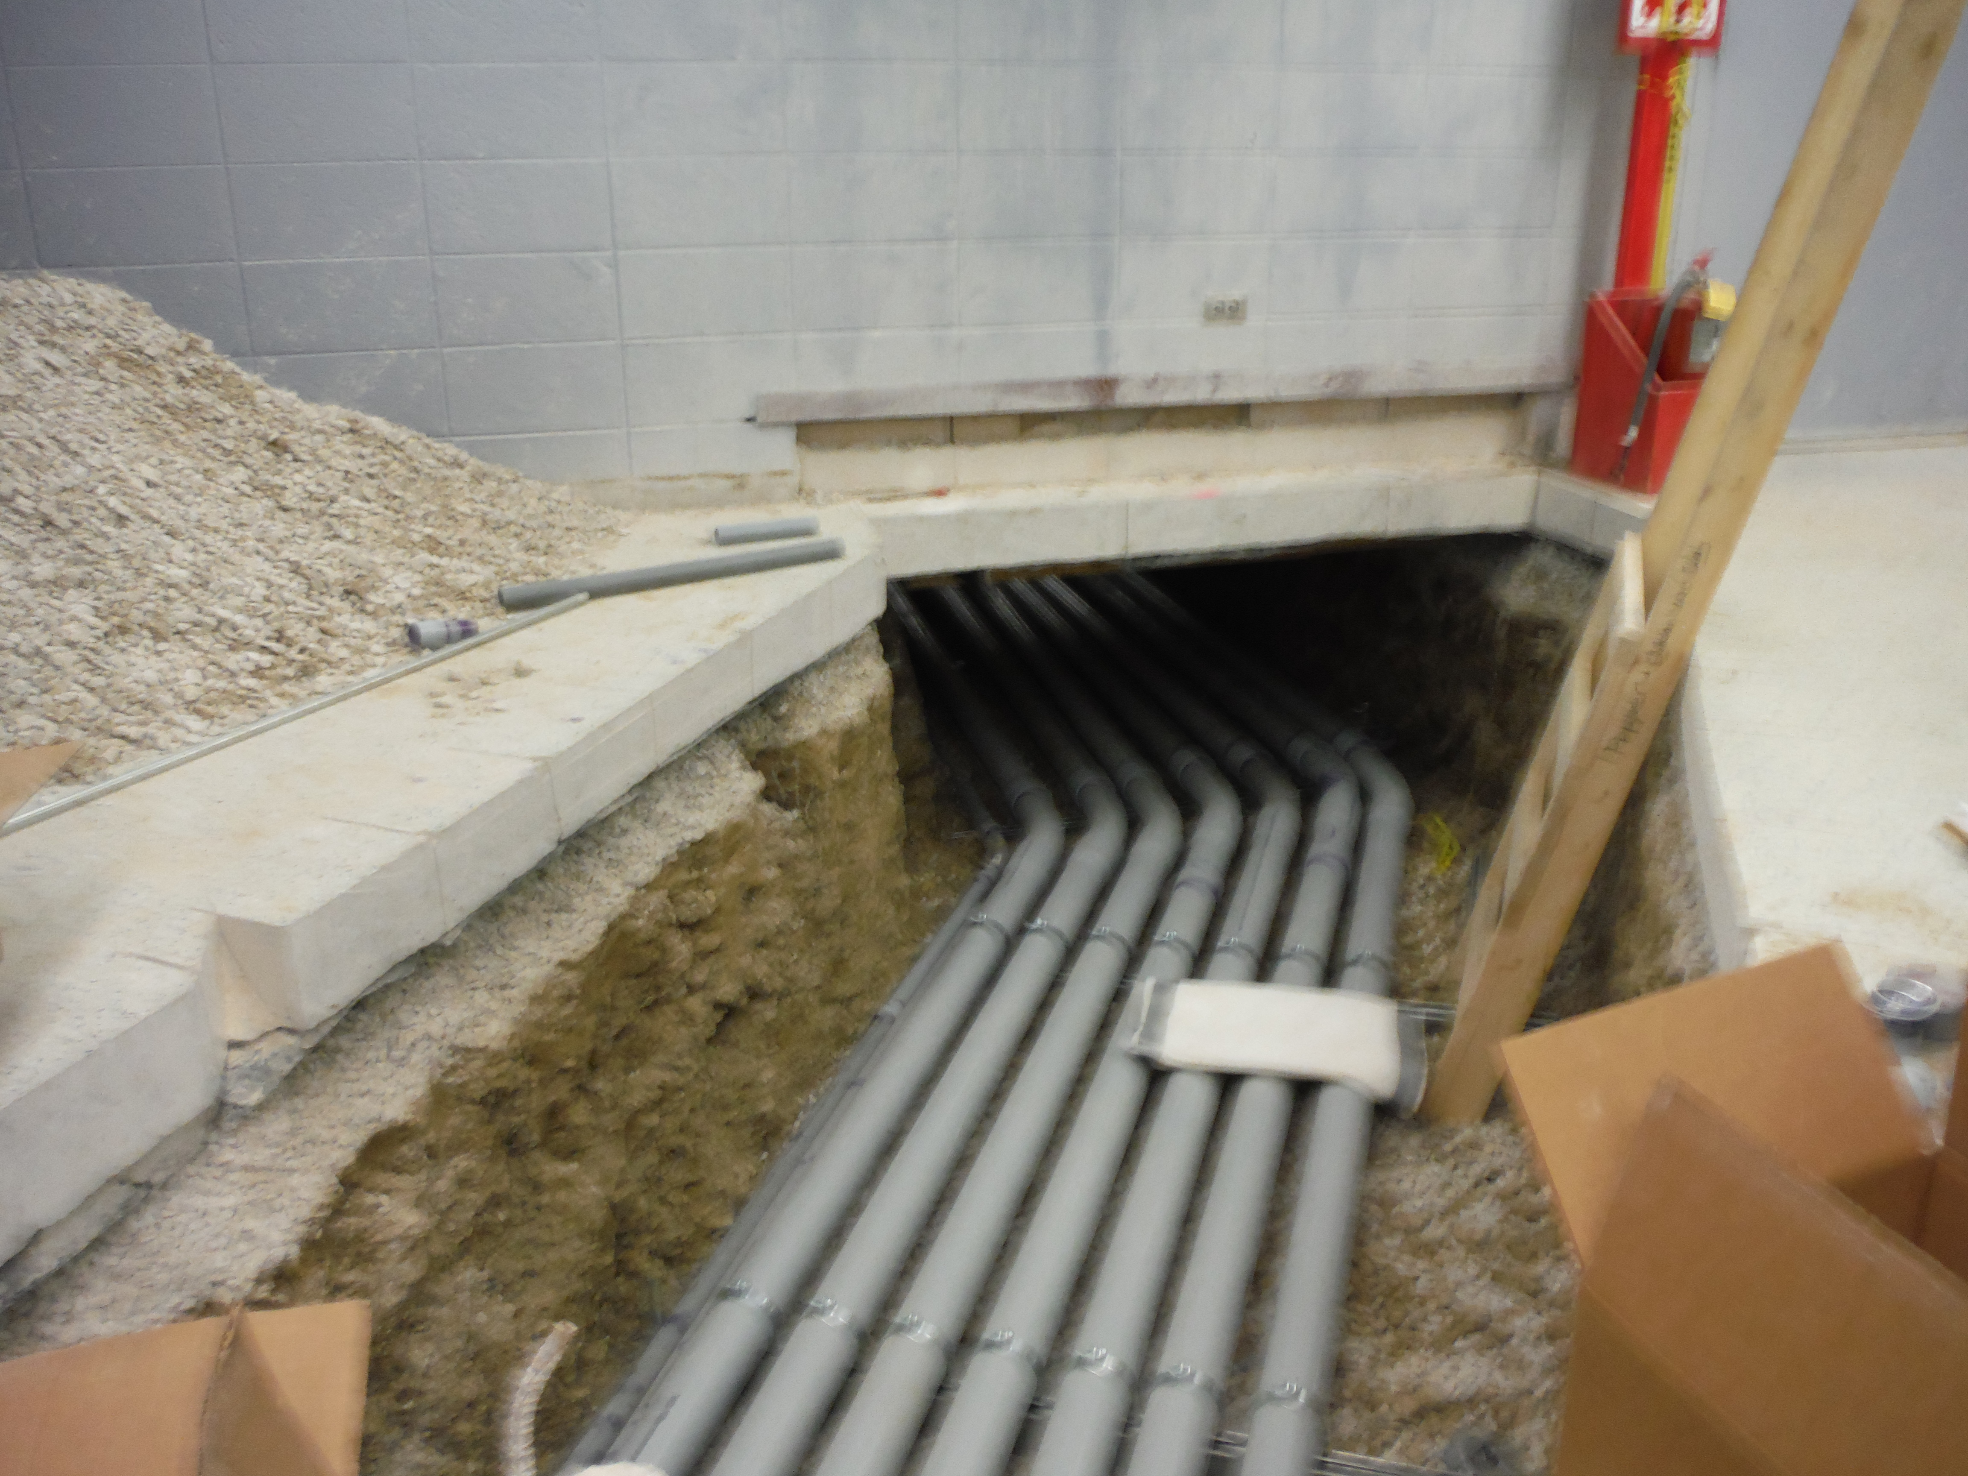
Sonoma Underground Services
Directional Drilling:
Large Diameter
Multiple Conduits
Rock Drilling
Conduit duct packages

Slide 6
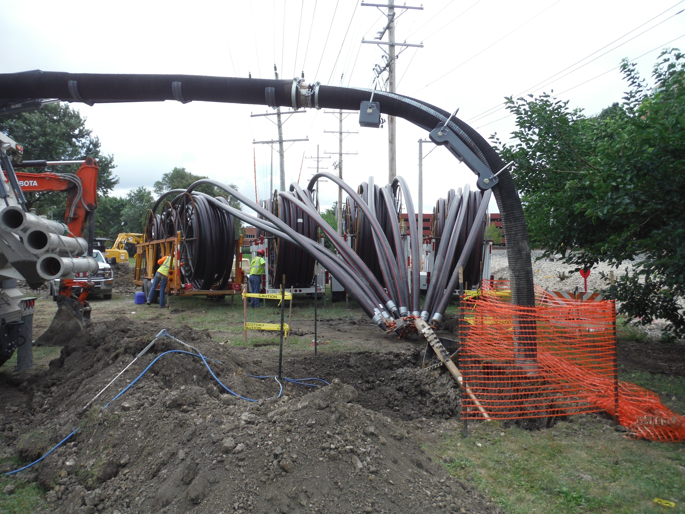
Multiple conduit placement
Sonoma Underground consists of an experienced labor force, with vast knowledge in directional boring and chemical mixture, which aides in our success of multiple conduit placement.

Slide 7
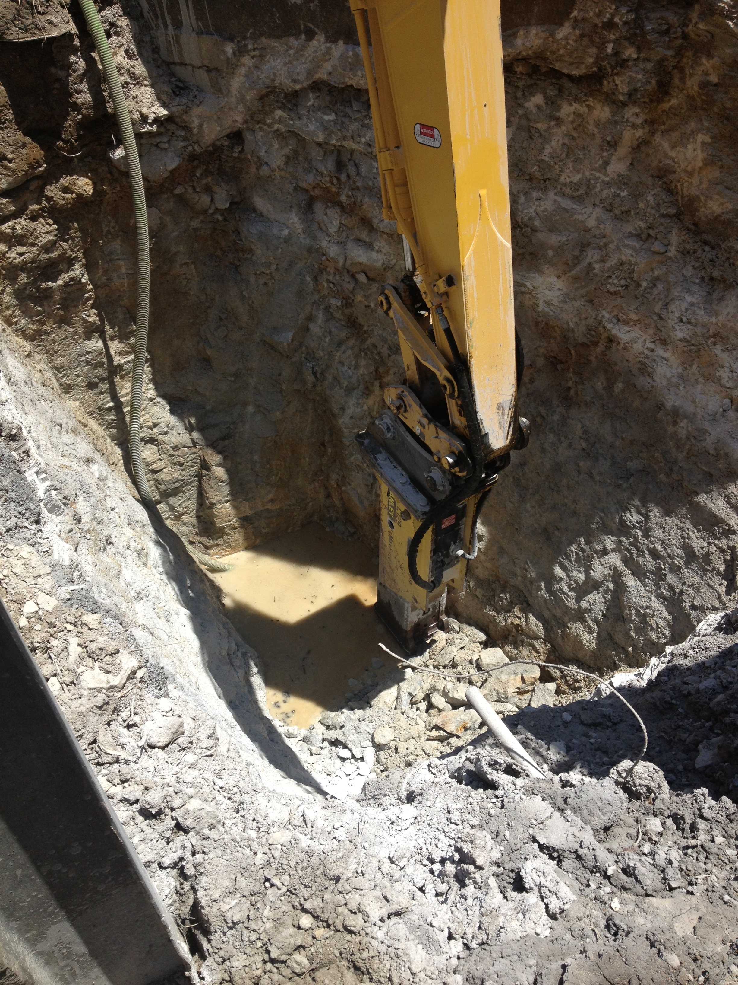
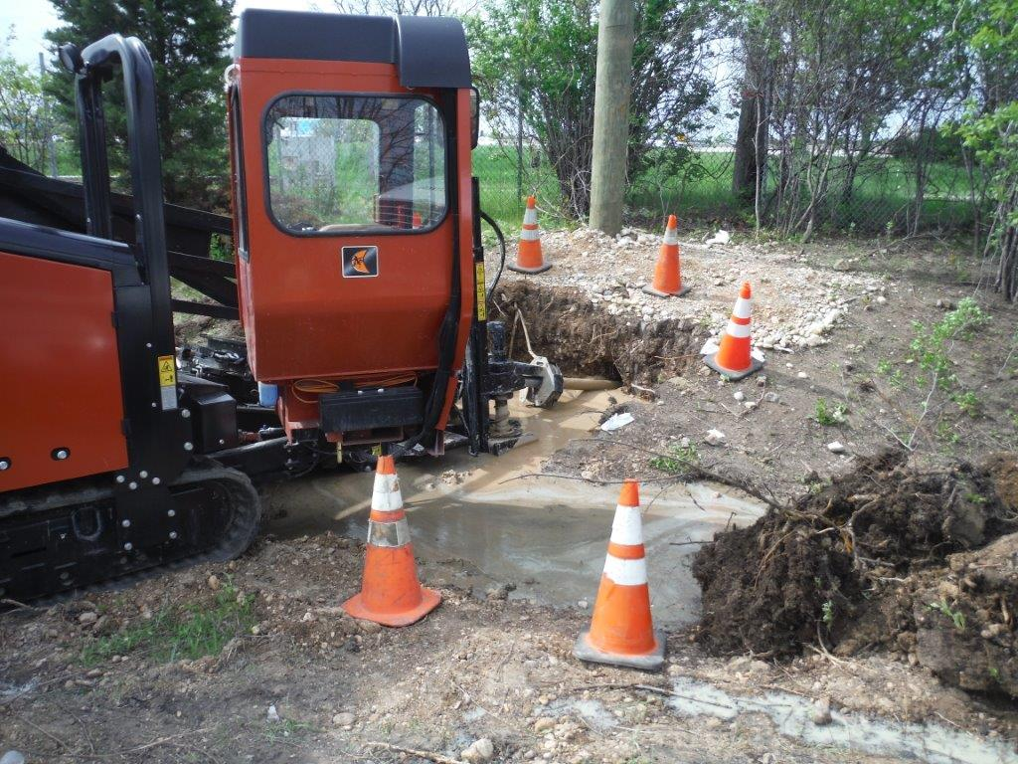
Rock Drilling
Sonoma Underground utilizes state of the art rock drilling equipment to ensure the highest rate of success during any rock project

Slide 8
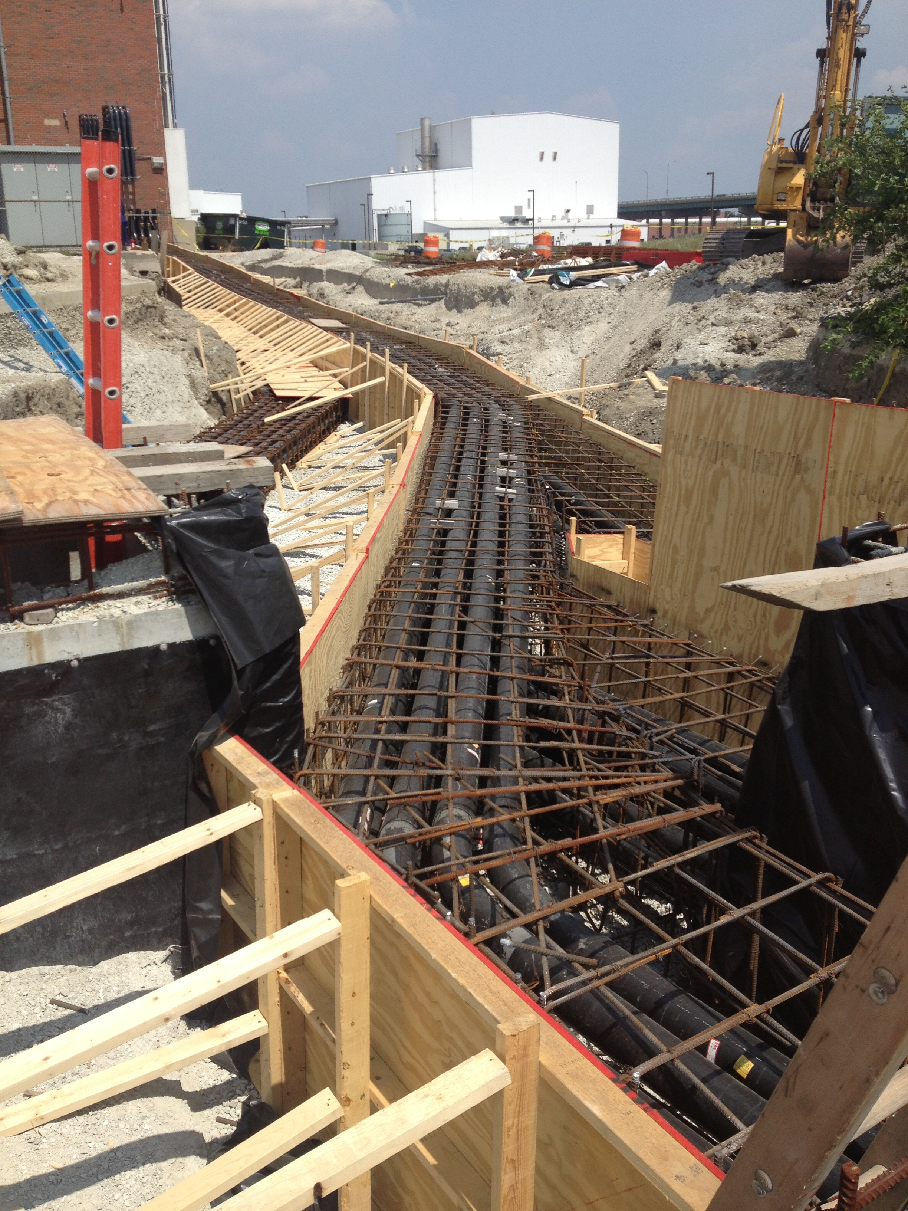
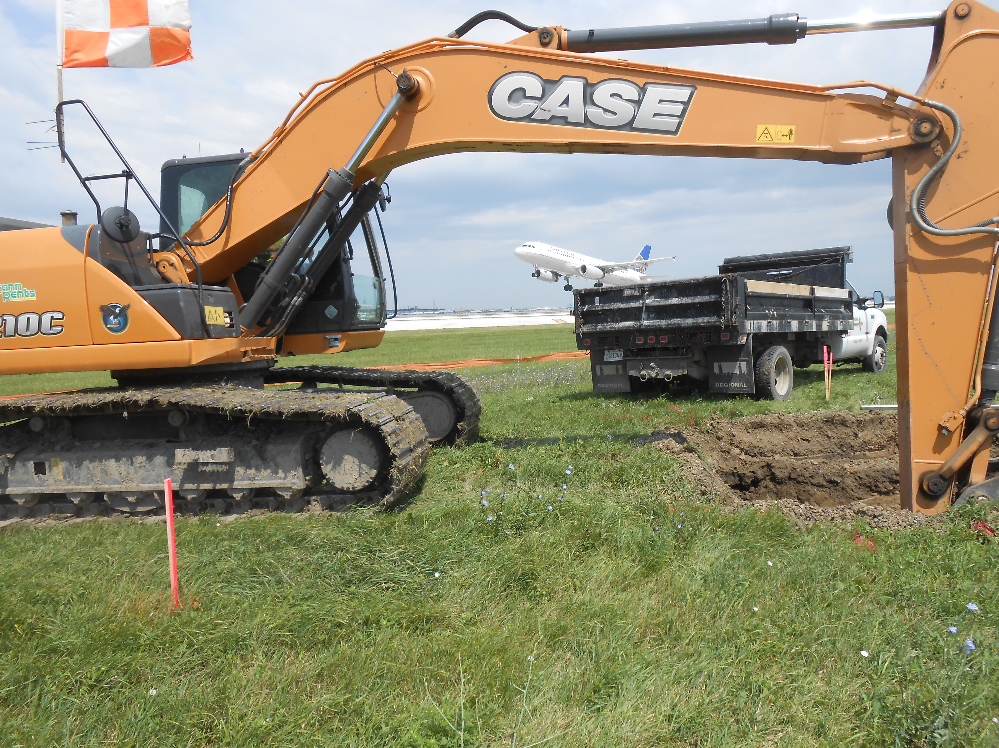
Additional services

